Slide 1

Name- Chetan patil Topic-

Slide 2
What is Openshift ?
OpenShift is a cloud development Platform as a Service (PaaS) developed by Red Hat.
It is an enterprise development platform, which enables developers to develop and deploy their applications on cloud infrastructure.
It is built on top of kuberentes
With OpenShift, PaaS developer has the freedom to design their required environment with specifications.

Slide 3
Features
Openshift provides certified docker image
Centralized management of containers
Auto-Scalability or high performance
Load balancing
Failure recovery-backup or restore

Slide 4
Layers and Componenets :
Infrastructure layer
Service layer
Main node
Worker nodes
Registry
Persistent storage
Routing layer

Slide 5
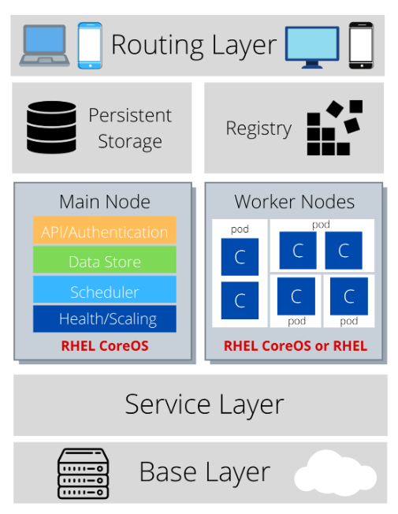
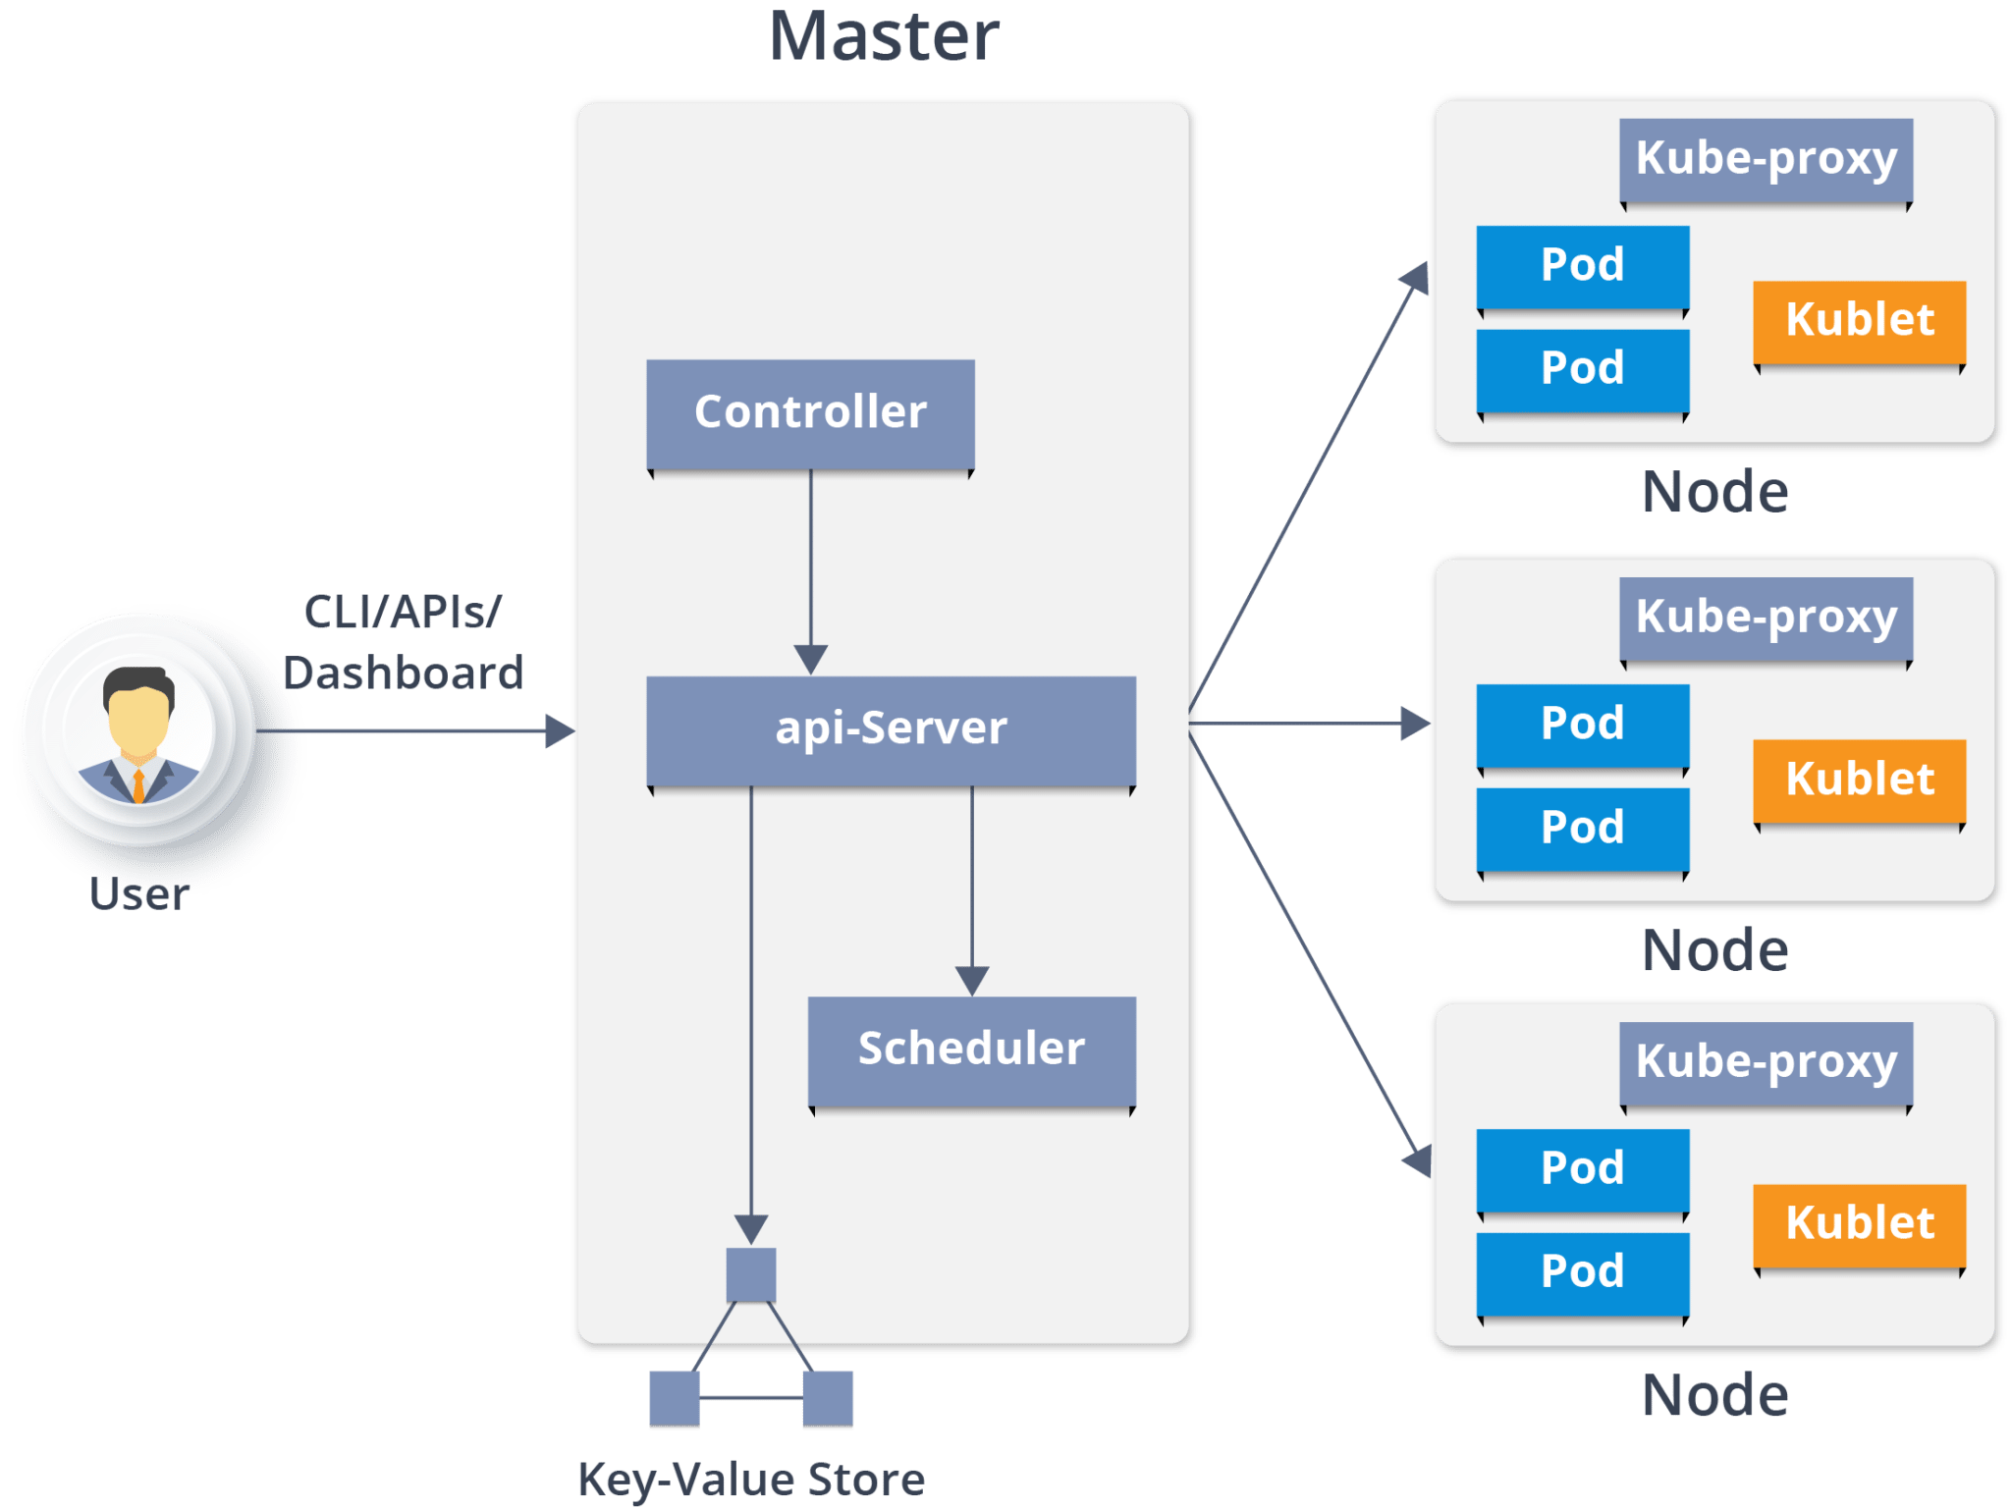



Openshift Architecture

Slide 6
Infrastructure layer
In the infrastructure layer, you can host your applications on physical servers, virtual servers, or even on the cloud (private/public).

Slide 7
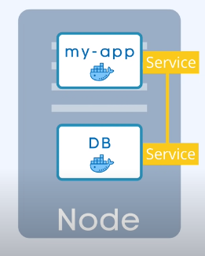
Service layer
The service layer is responsible for defining pods and access policy.
The service layer provides the pods with a permanent IP address and hostname, connects applications together, and allows simple internal load balancing.

Slide 8
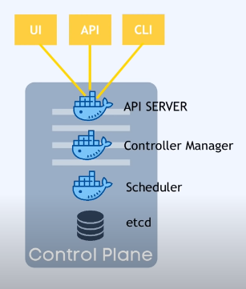
Master Node
API Server - Acts as the frontend to the cluster. All external communication to the cluster is via the API Server.
Controller Manager -Keeps tracks of what happening in cluster
Scheduler –Ensures pod placements
etcd- Kuberentes backing store

Slide 9
Worker nodes
the worker node is made of pods.
A pod is the smallest unit that can be defined, deployed, and managed, and it can contain one or more containers.
These containers include your applications and their dependencies.

Slide 10
Registry
The registry saves your images locally in the cluster. When a new image is pushed to the registry, it notifies OpenShift and passes image information.

Slide 11
Persistent storage
Persistent storage is where all of your data is saved and connected to containers.
It is important to have persistent storage because containers are ephemeral, which means when they are restarted or deleted, any saved data is lost.
Therefore, persistent storage prevents any loss of data and allows the use of stateful applications

Slide 12
Routing layer
The last component is the routing layer. It provides external access to the applications in the cluster from any device.
It also provides load balancing and auto-routing around unhealthy pods.

Slide 13
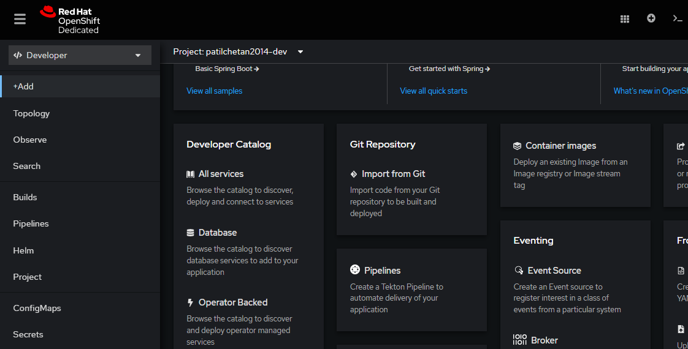
Deployment on openshift

Slide 14
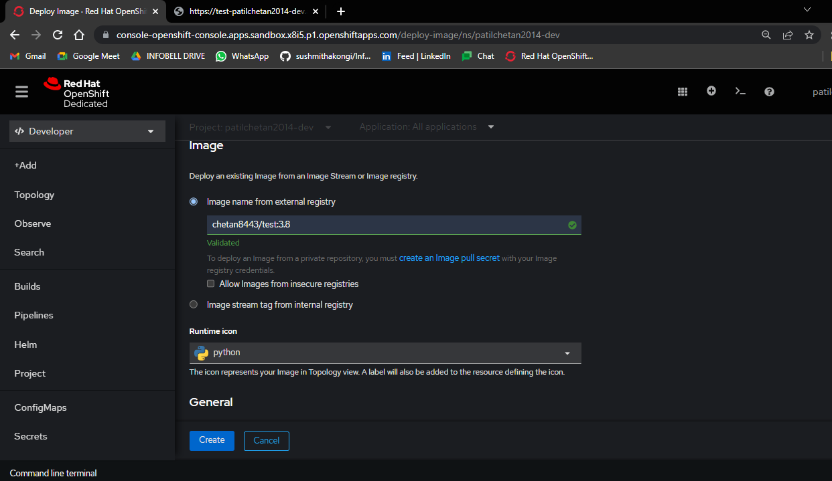
Deployment on openshift

Slide 15
